Slide 1
cease
Hardware assisted companion app to aid cigarette smokers in quitting
Abhijit Pranam
Joshua (Jihang) Lim
Ken Dong
Notes:
Animated for the start

Slide 2
Overall Problem
Smoking cessation methods are often tedious
Smokers who rely on willpower for smoking cessation often fail within 1 week
Tobacco use is the leading preventable cause of death in the U.S.
https://www.cdc.gov/tobacco/data_statistics/fact_sheets/adult_data/cig_smoking/index.htm
Notes:
BOTH

Slide 3
Our Approach
Generate a plan to taper smokers off cigarettes in a short period of time
Emphasis on autonomous tracking and data logging
Provide motivational support and advice from peers
Notes:
BOTH

Slide 4

Initial Paper Prototype

Slide 5
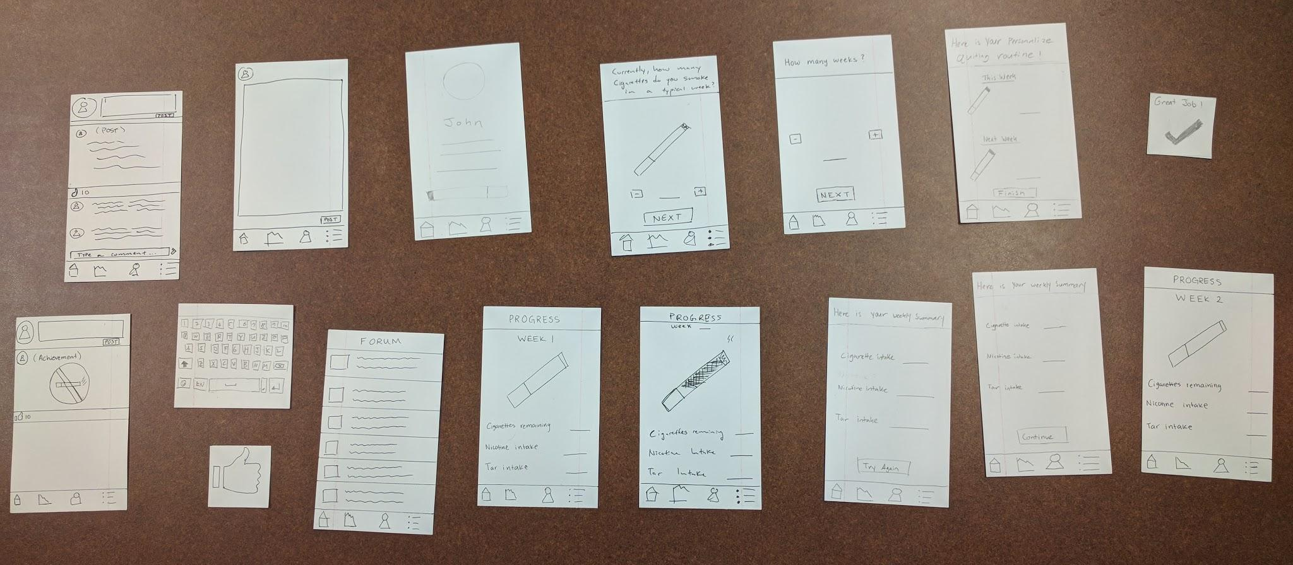
Initial Paper Prototype

Slide 6
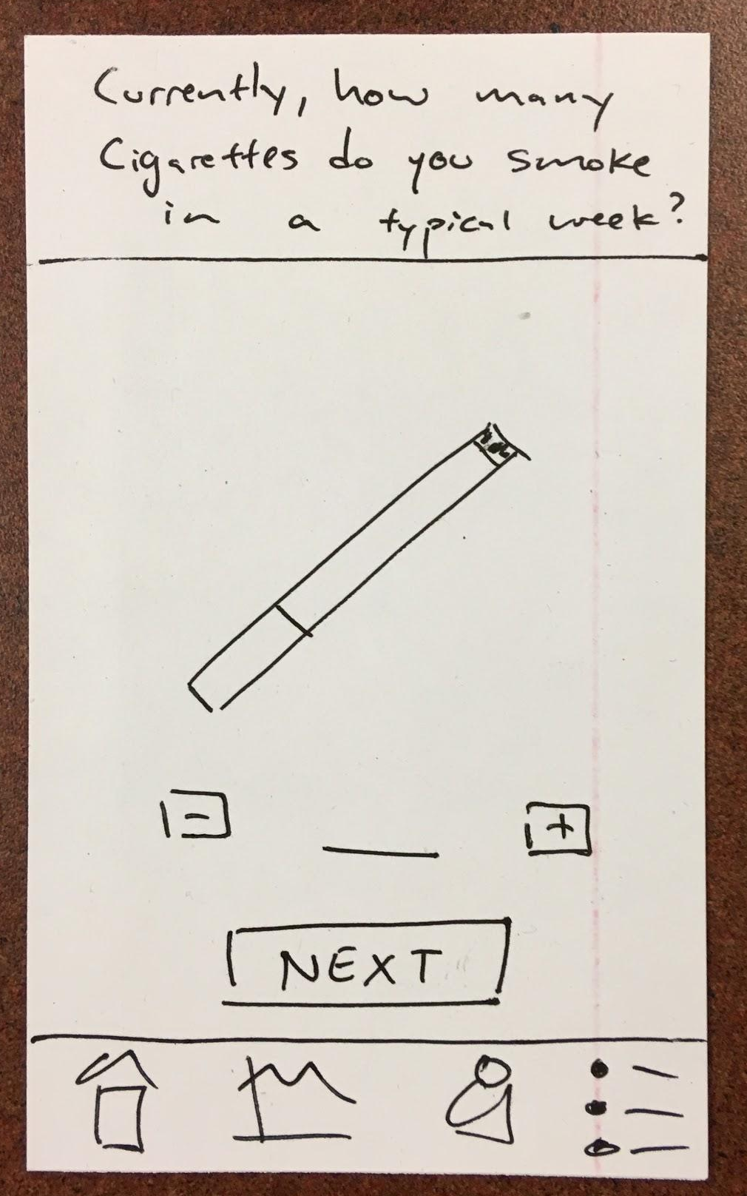
Task 1: Application Setup & Tracking Nicotine/Tar Intake

Slide 7
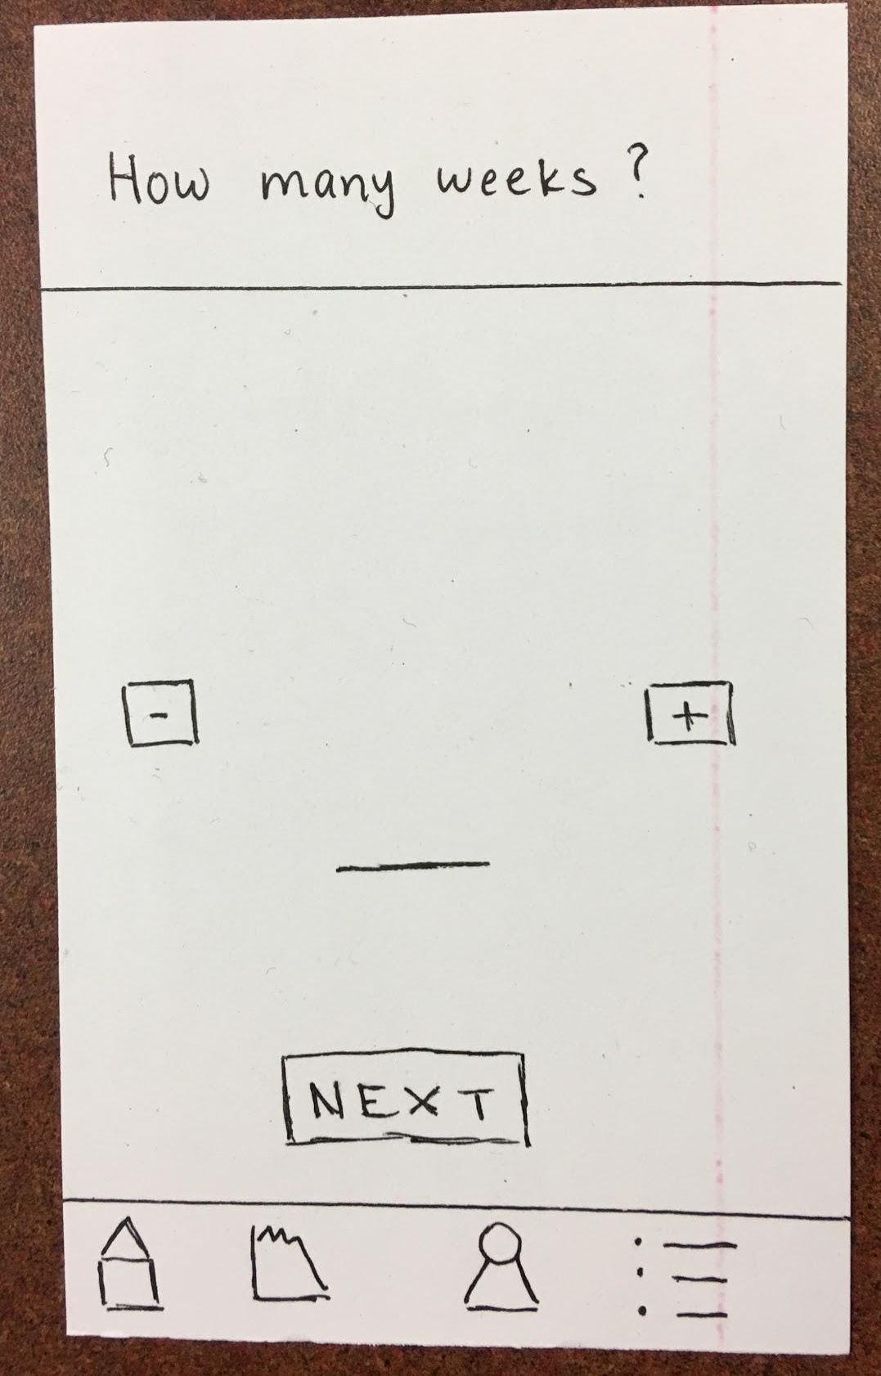
Task 1: Application Setup & Tracking Nicotine/Tar Intake

Slide 8
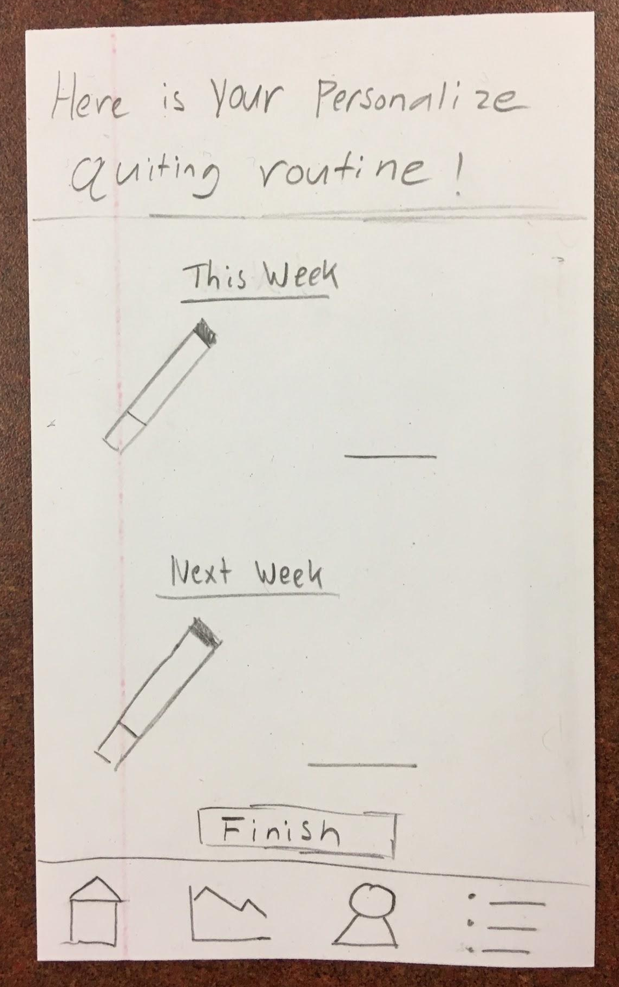
Task 1: Application Setup & Tracking Nicotine/Tar Intake

Slide 9
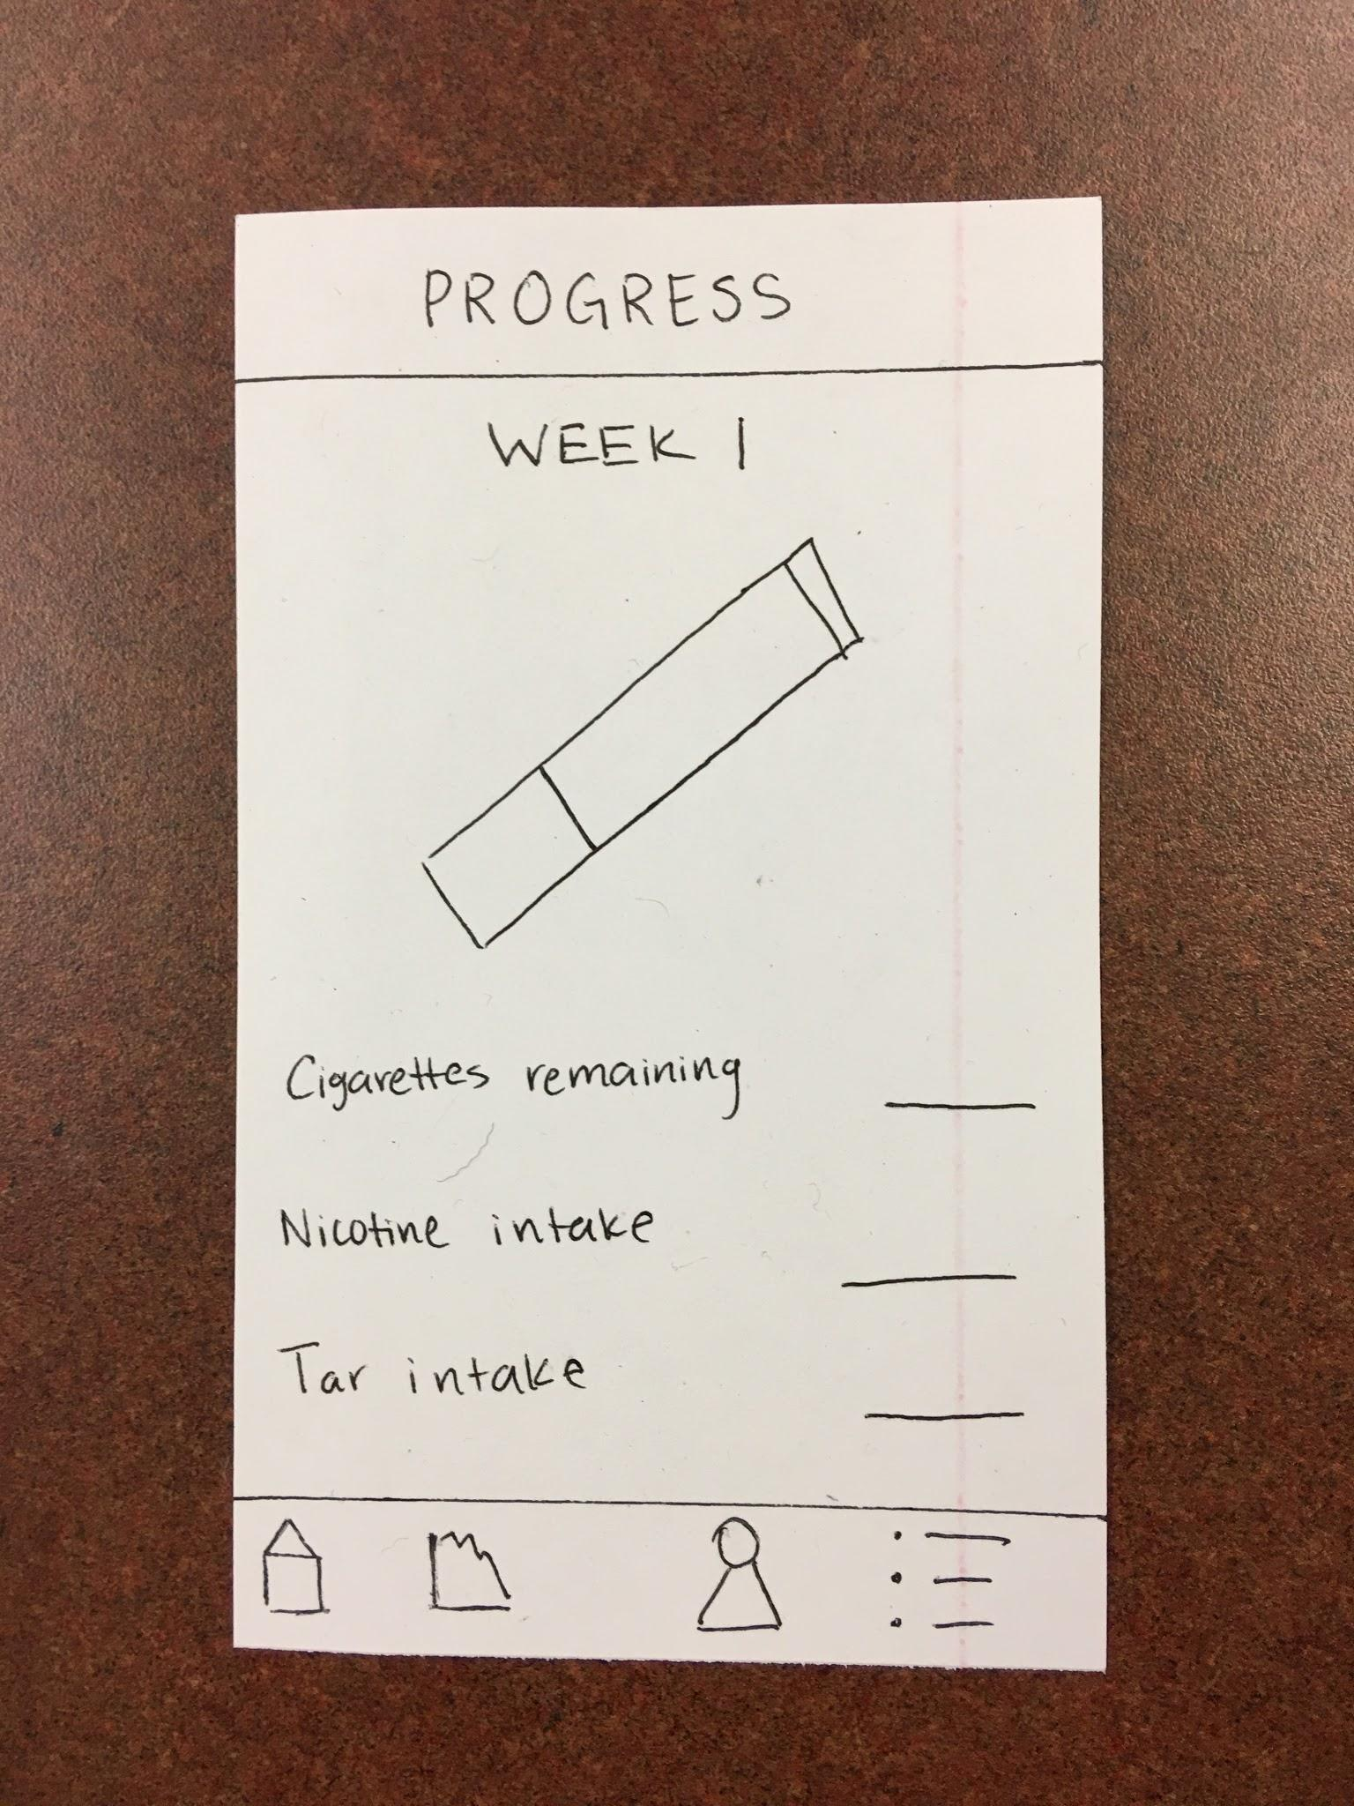
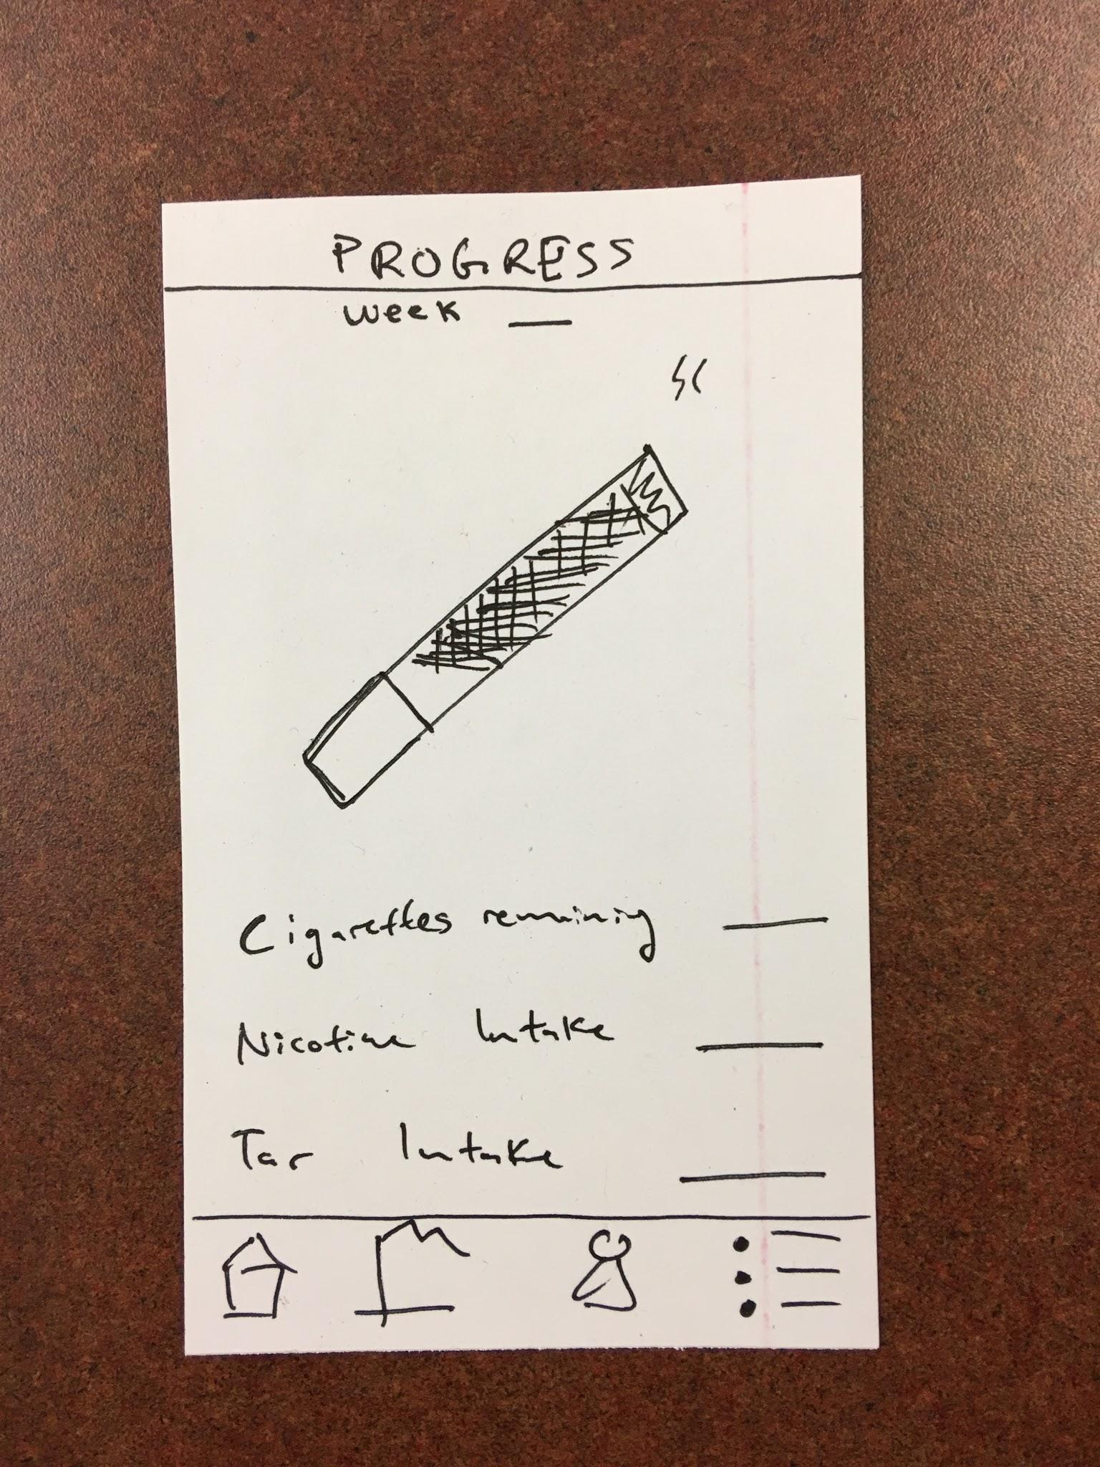
Task 1: Application Setup & Tracking Nicotine/Tar Intake

Slide 10
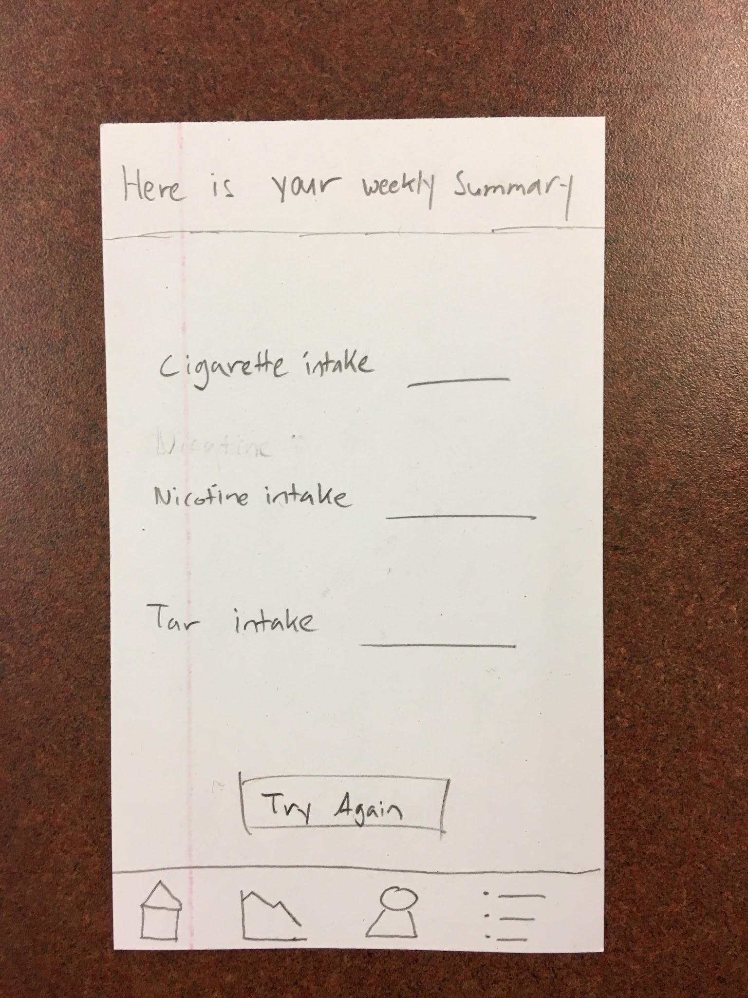
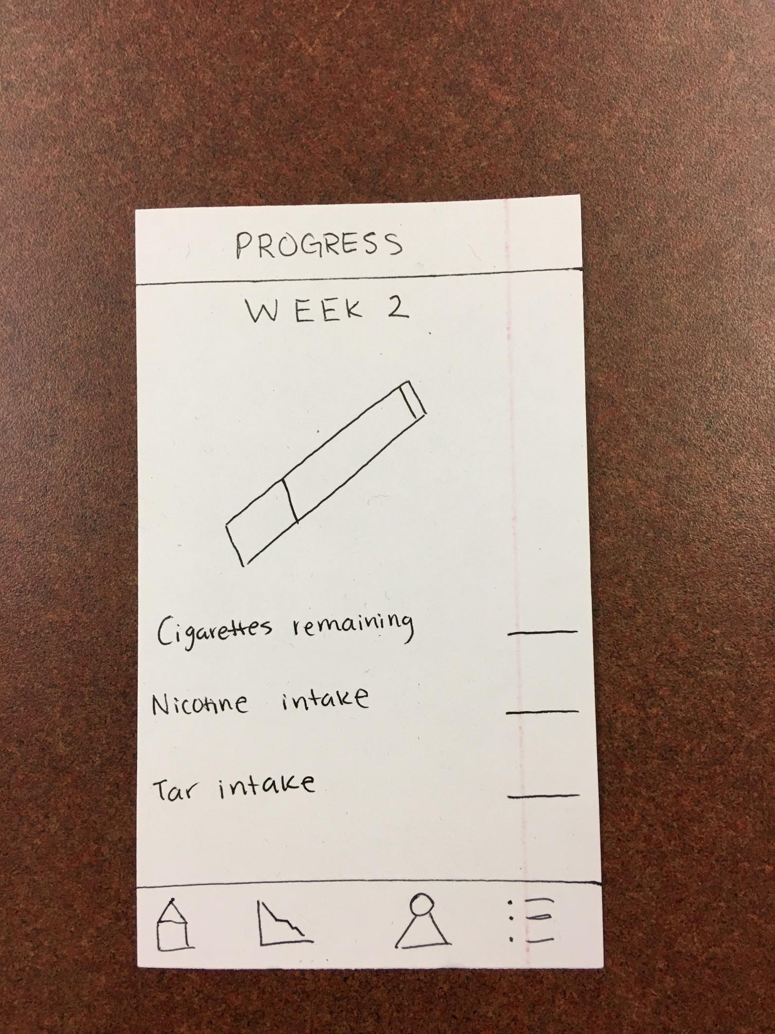
Task 1: Application Setup & Tracking Nicotine/Tar Intake

Slide 11
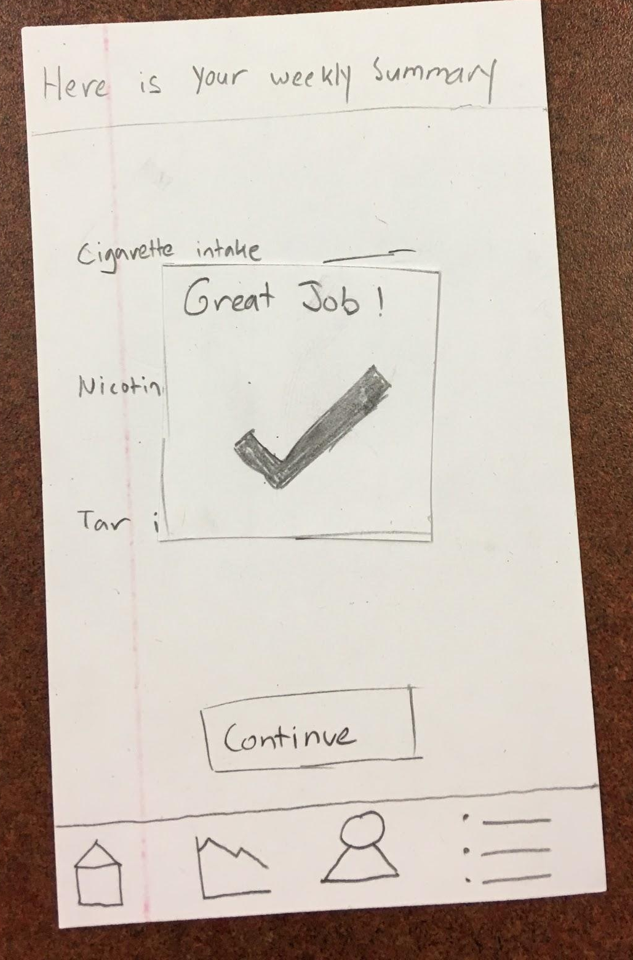
Task 1: Application Setup & Tracking Nicotine/Tar Intake

Slide 12
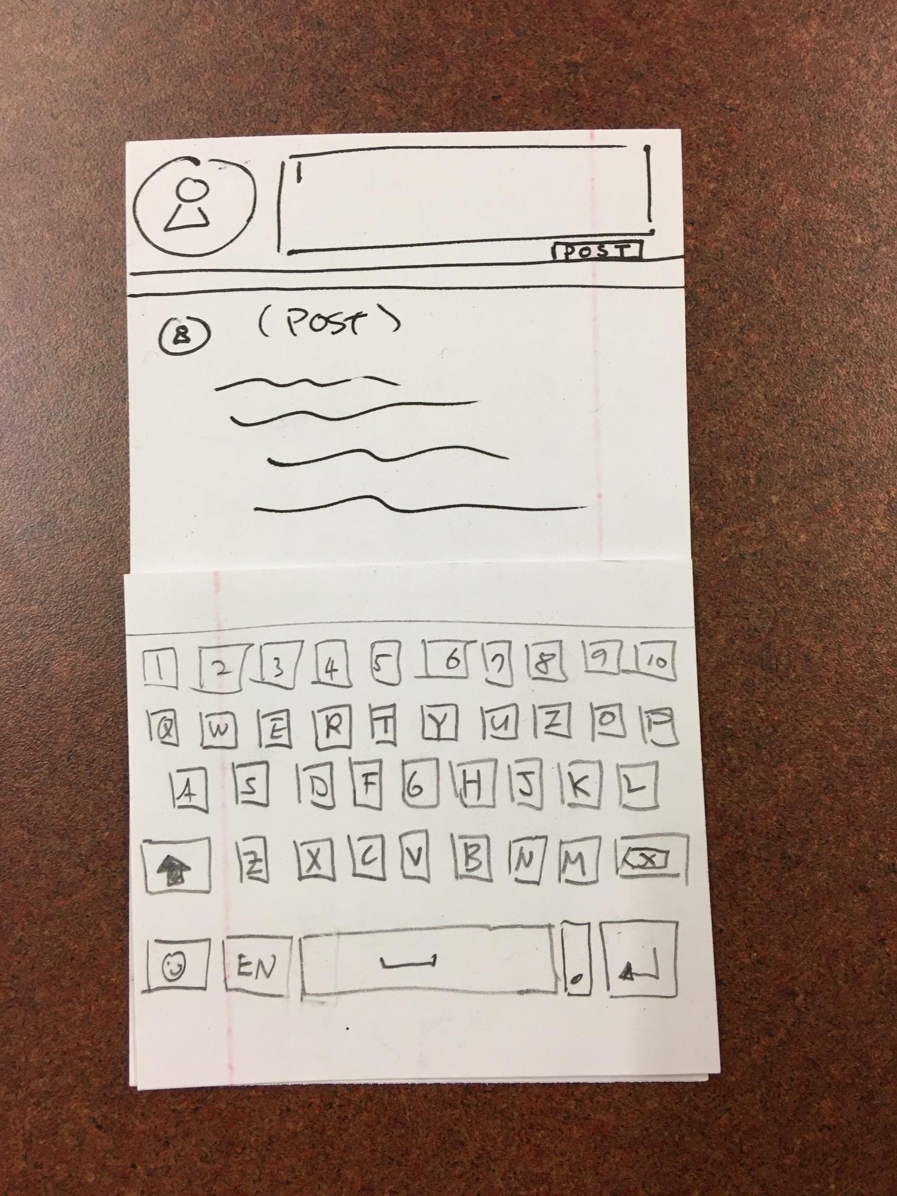
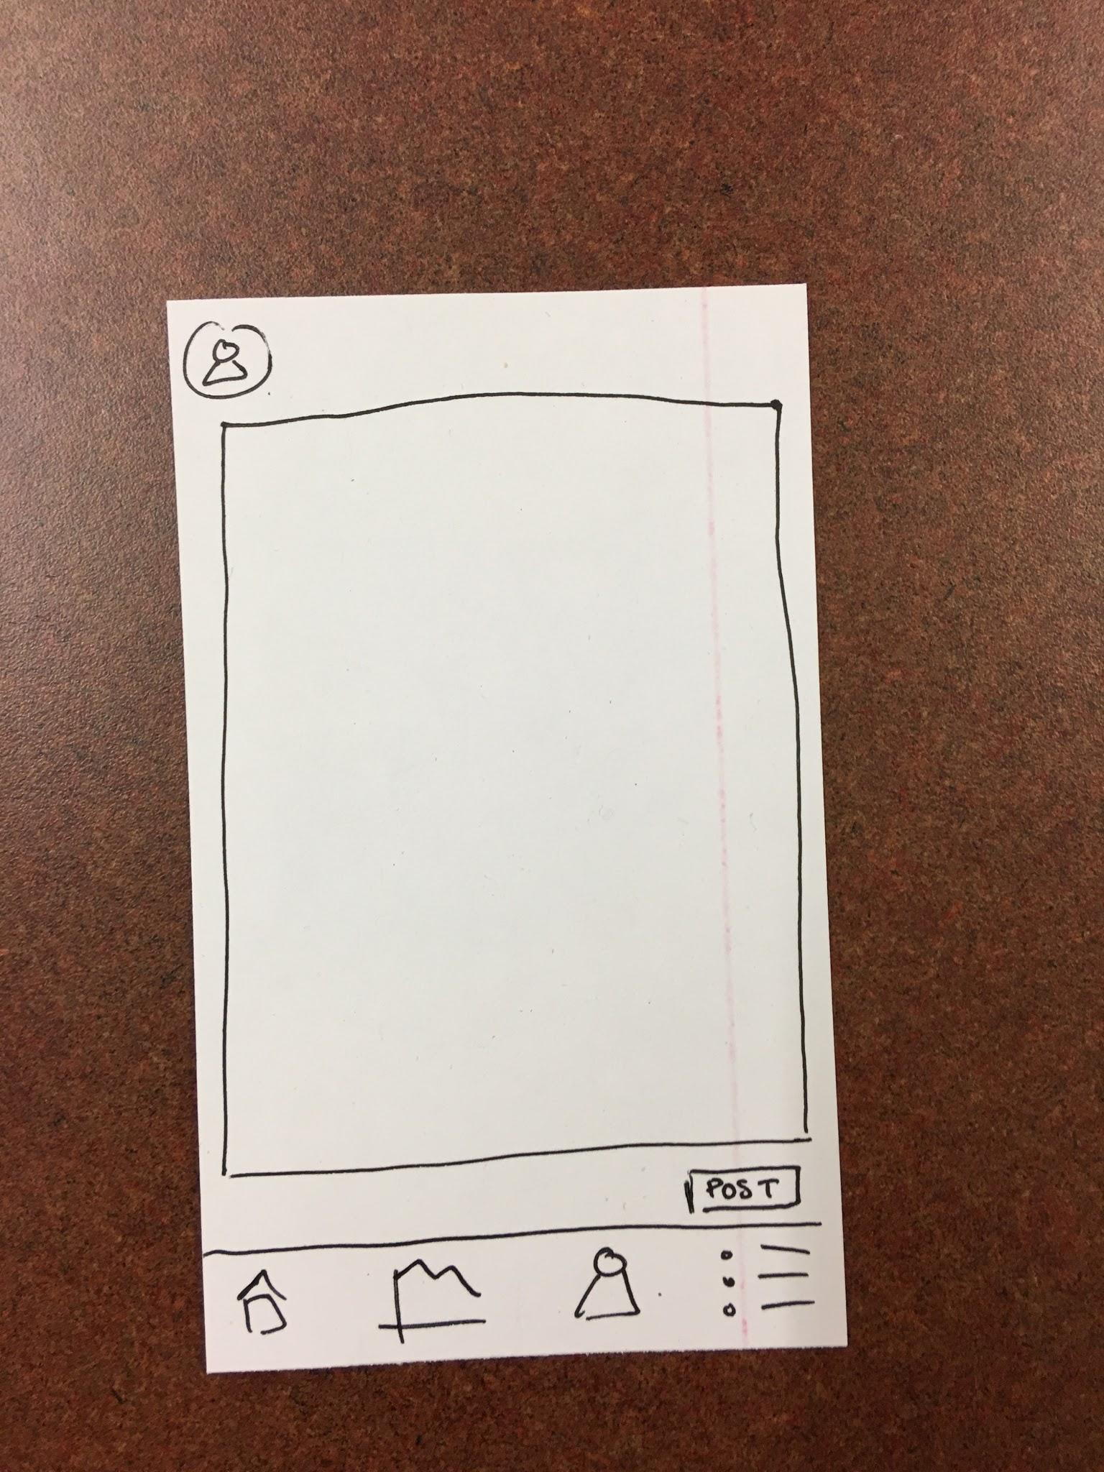
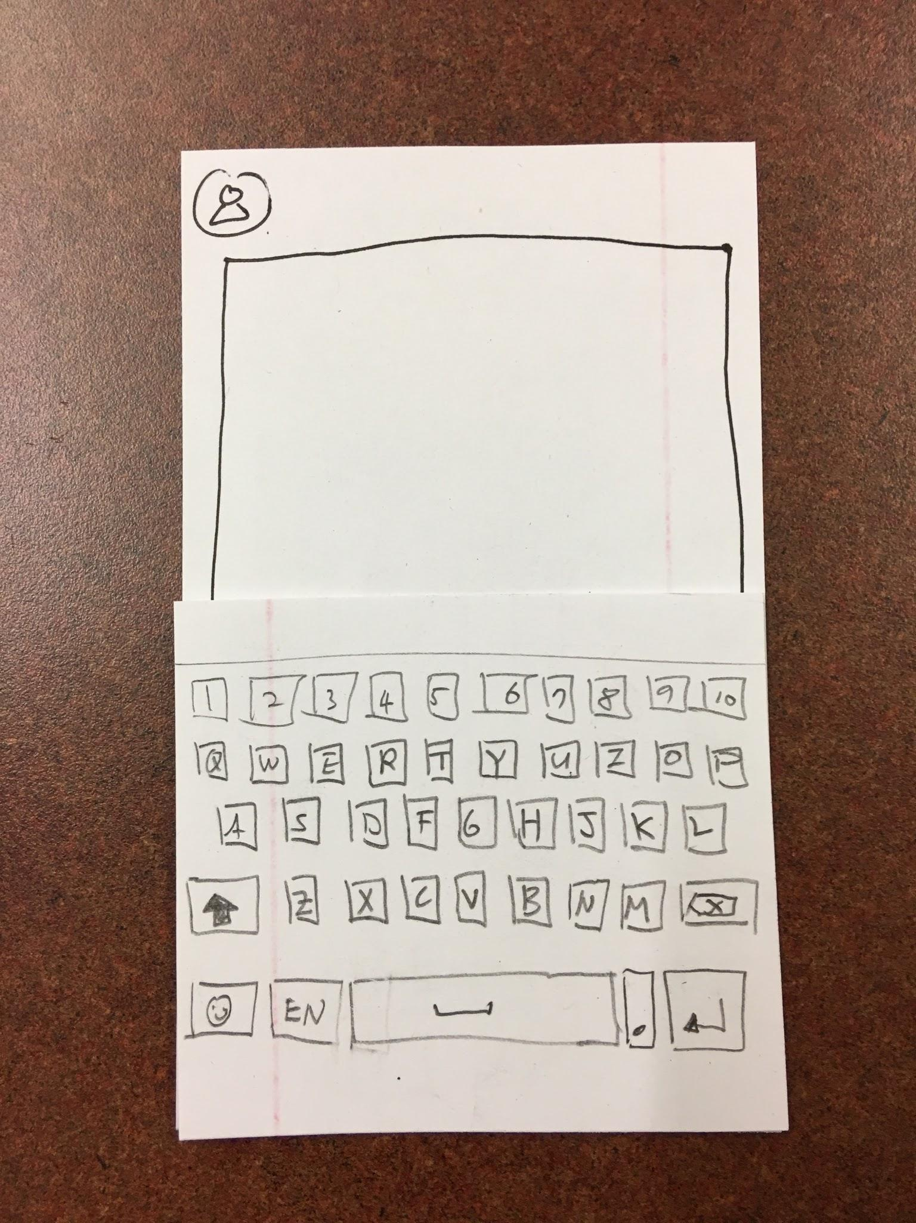
Task 2: Posting to Buddy Social Network

Slide 13
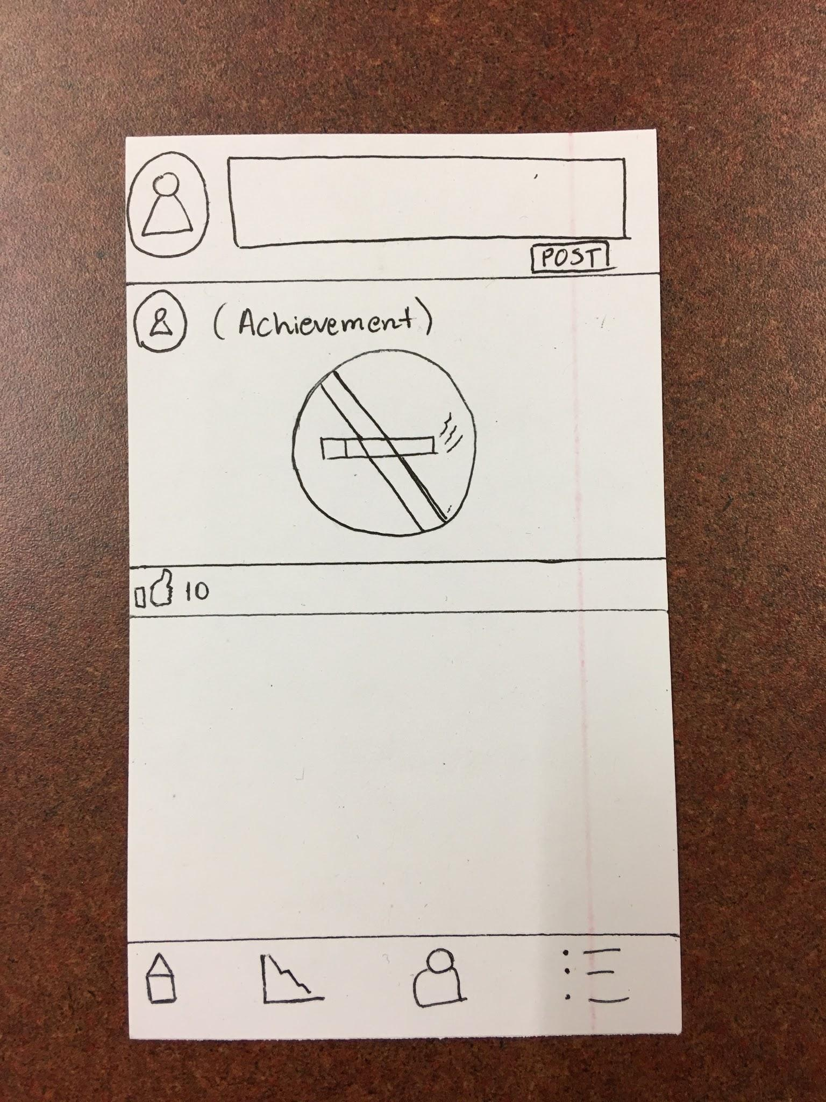
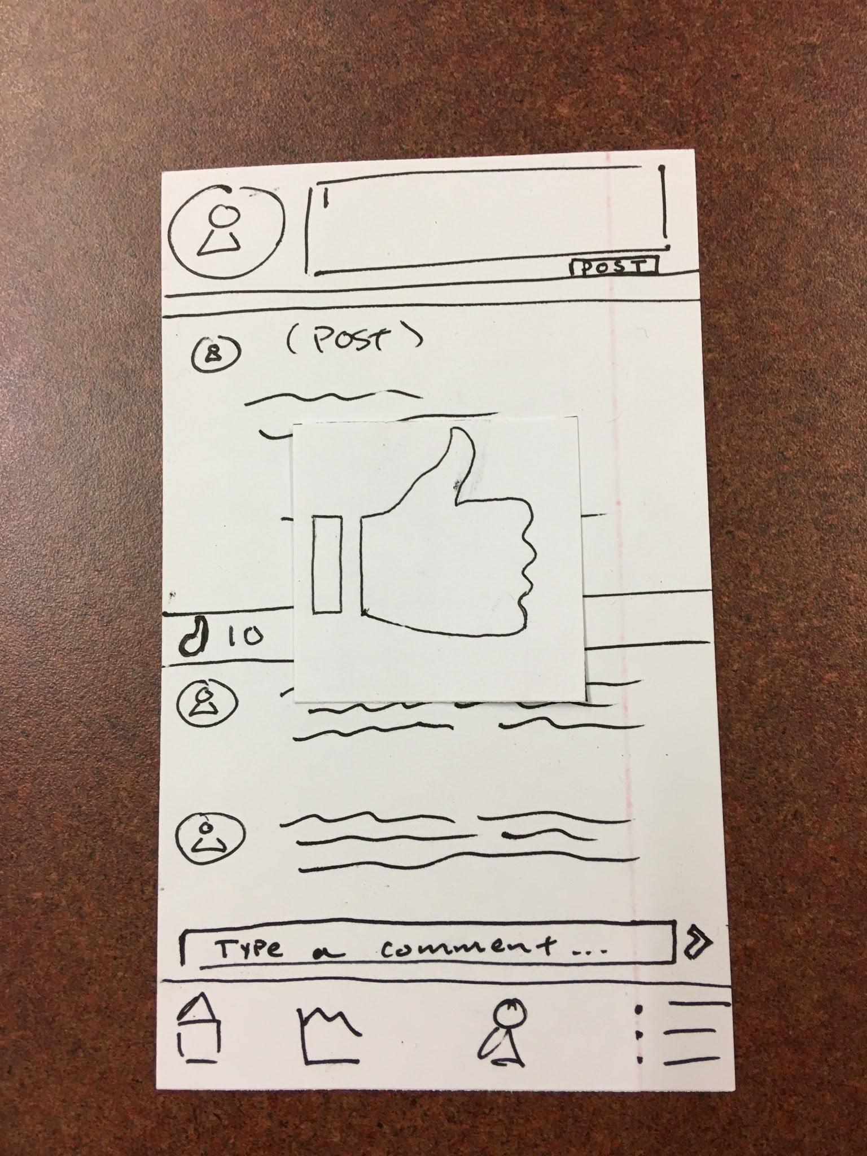
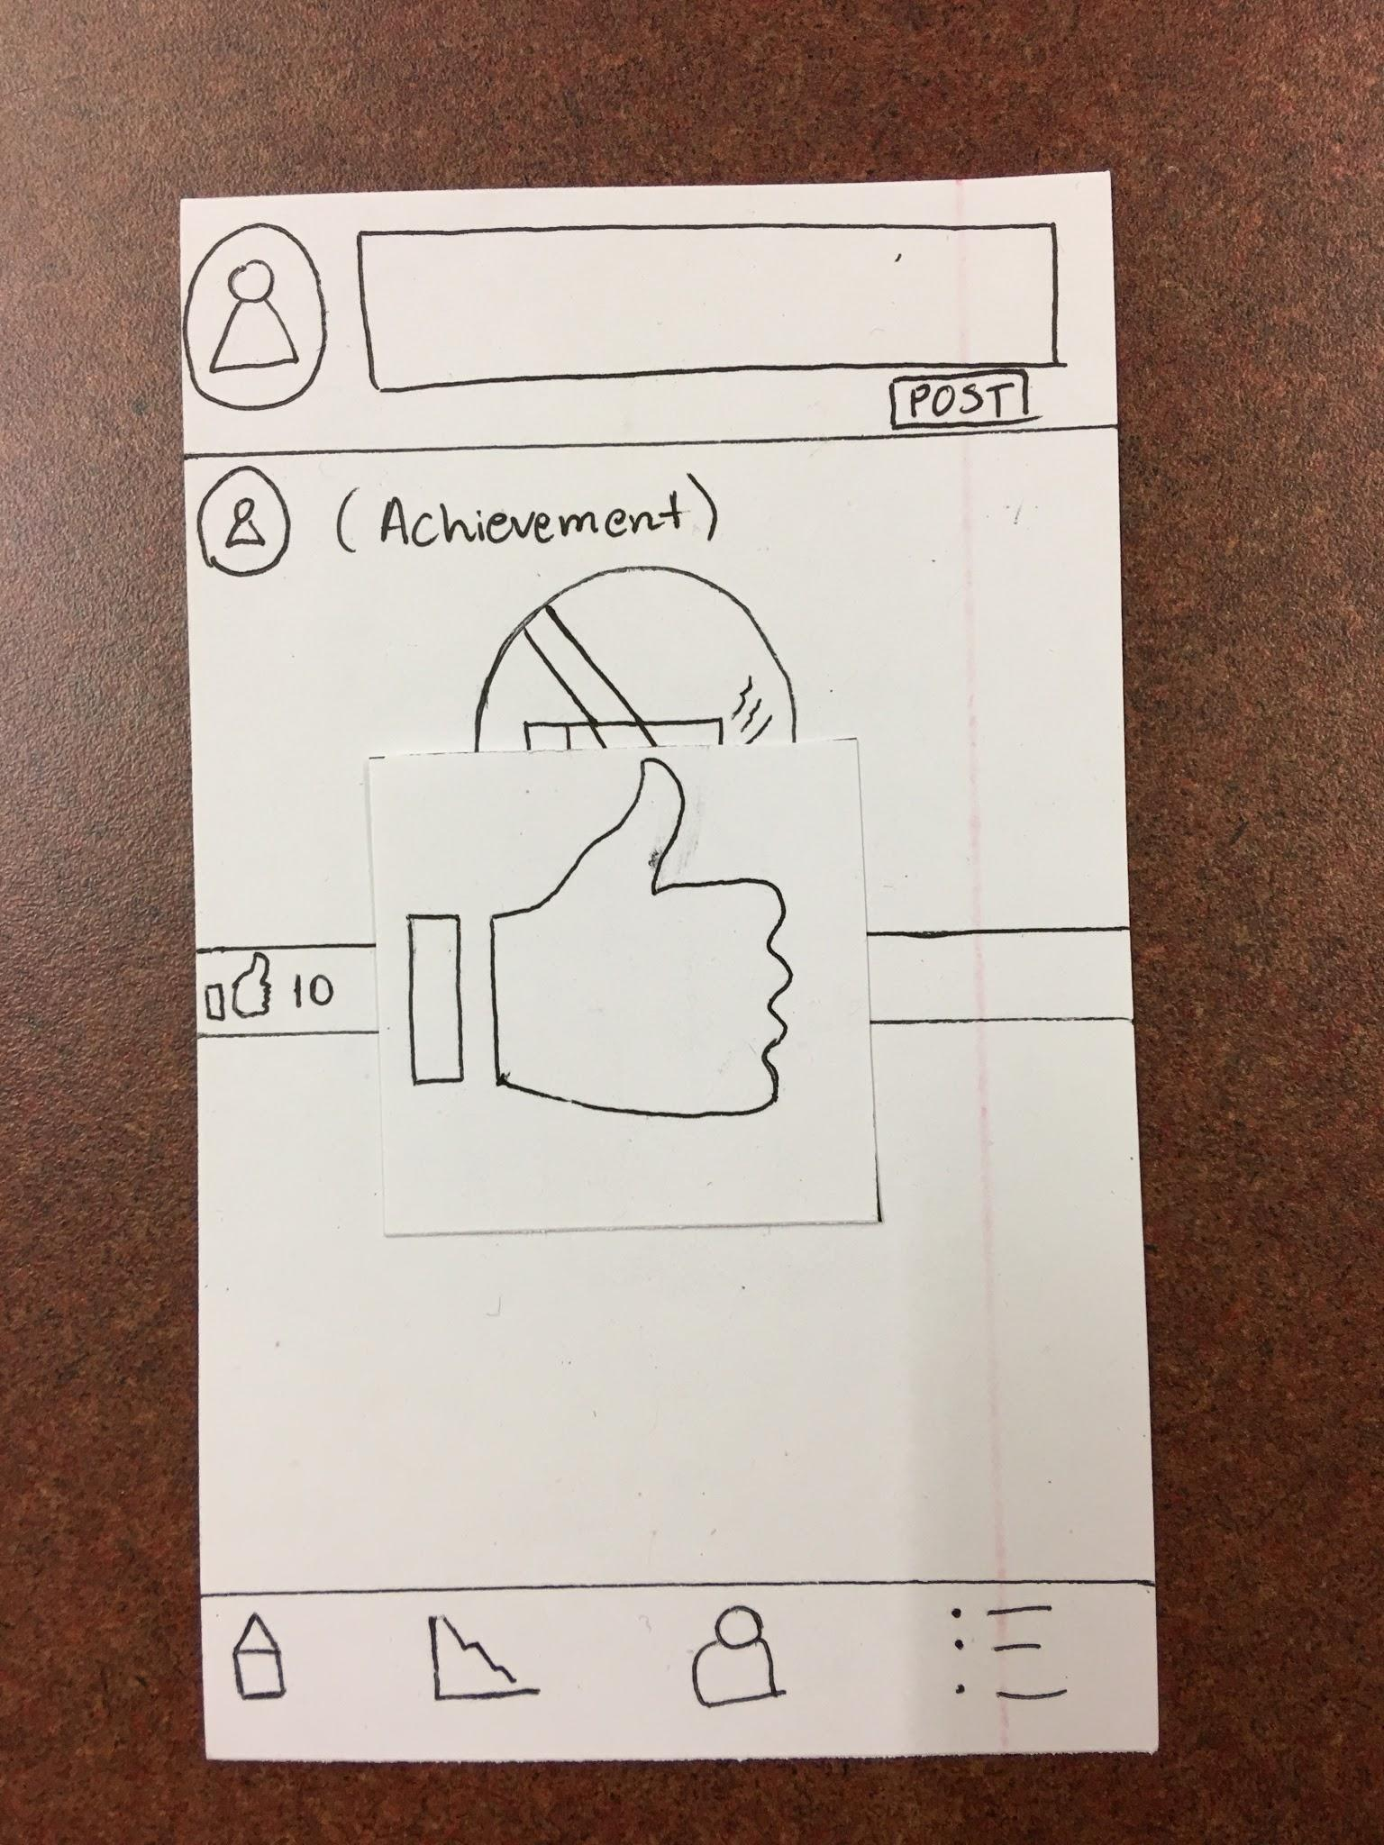
Task 2: Posting to Buddy Social Network

Slide 14
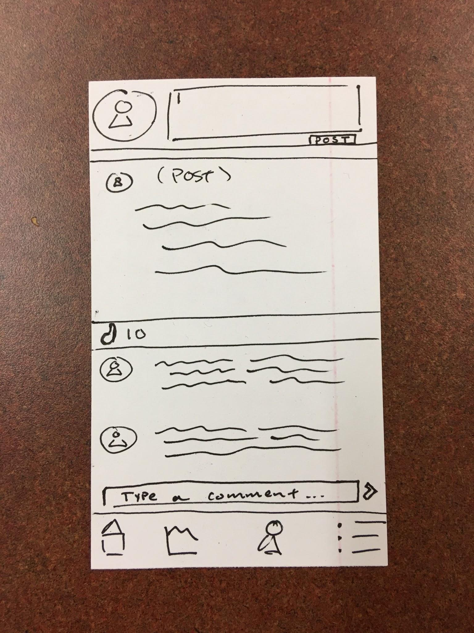
Task 2: Posting to Buddy Social Network

Slide 15
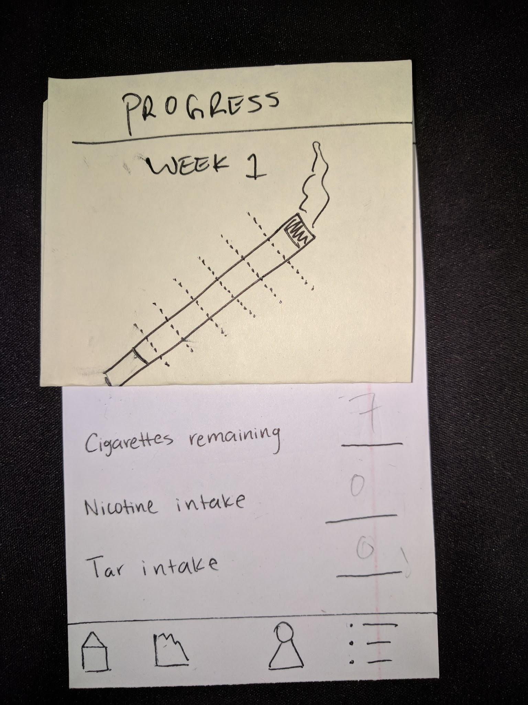
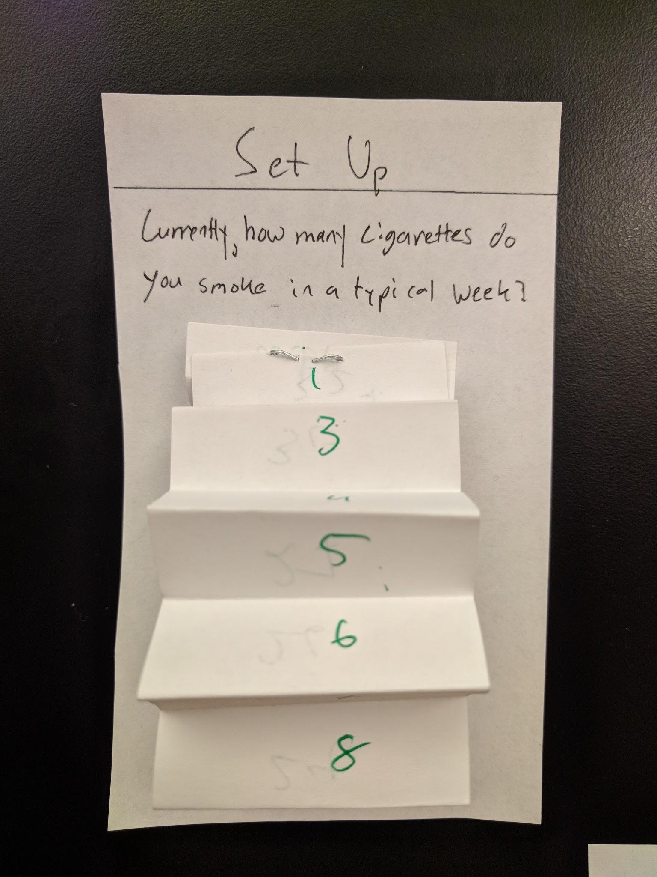
Testing Process
Participants included smokers/non-smokers with various tech backgrounds
Directed participants to complete tasks
Participants revealed problems with design clarity and consistency
Revealed problems with information visualization

Slide 16
Final Paper Prototype

Slide 17
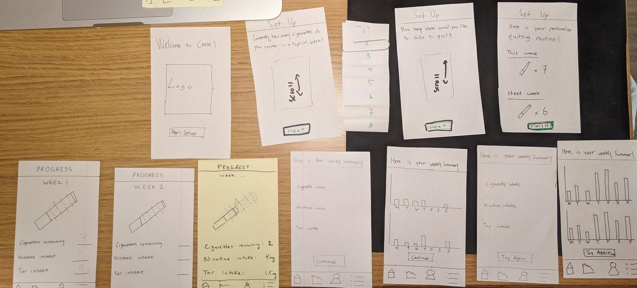
Final Paper Prototype
The nicotine and tar tracking half of Cease

Slide 18
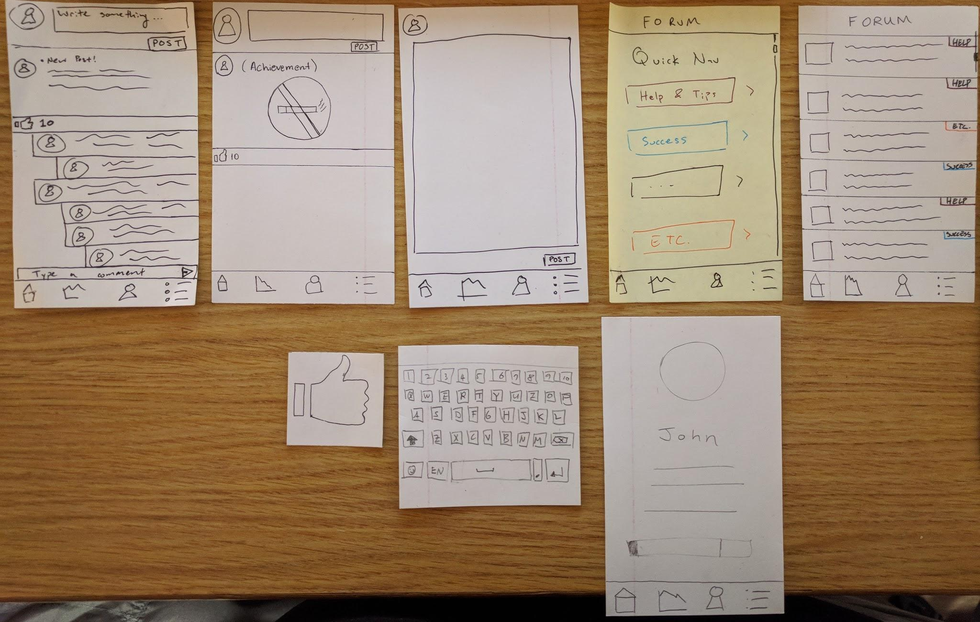
Final Paper Prototype
The social media aspect of Cease

Slide 19
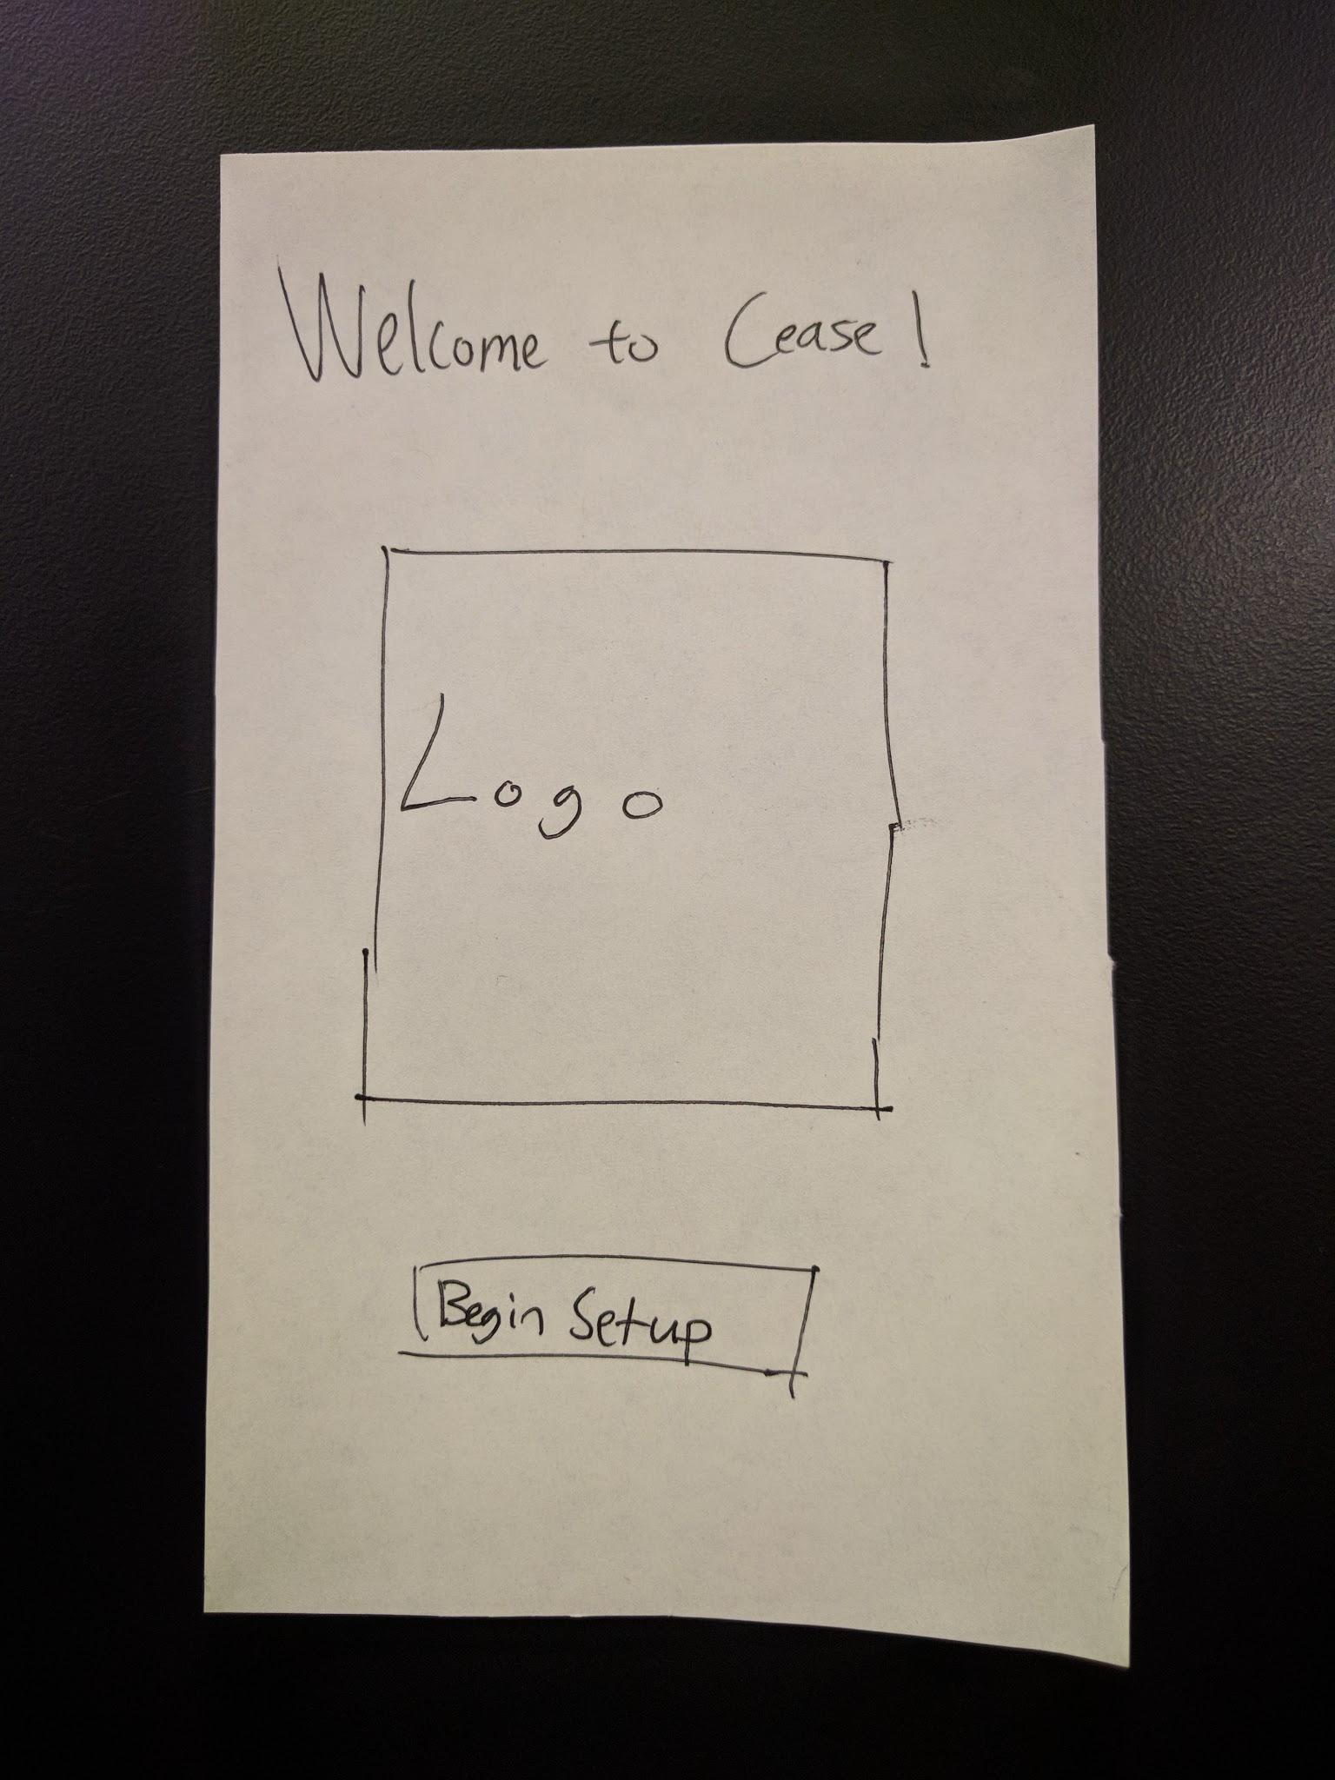
Task 1: Initial Setup and Tracking Nicotine/Tar

Slide 20
Task 1: Initial Setup and Tracking Nicotine/Tar

Slide 21
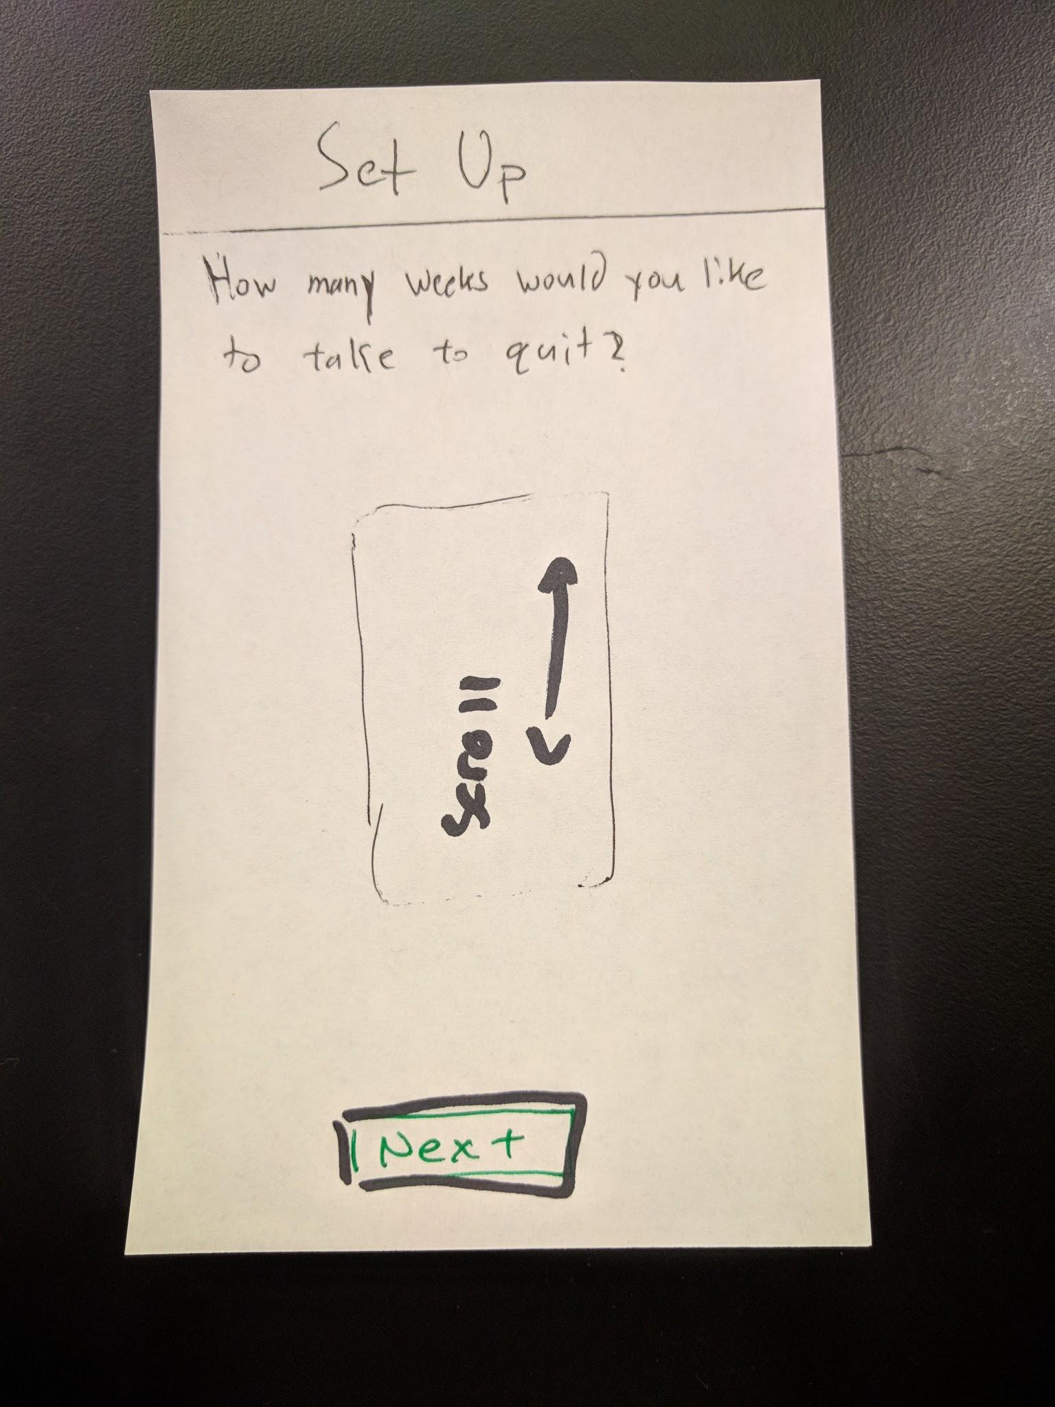
Task 1: Initial Setup and Tracking Nicotine/Tar

Slide 22
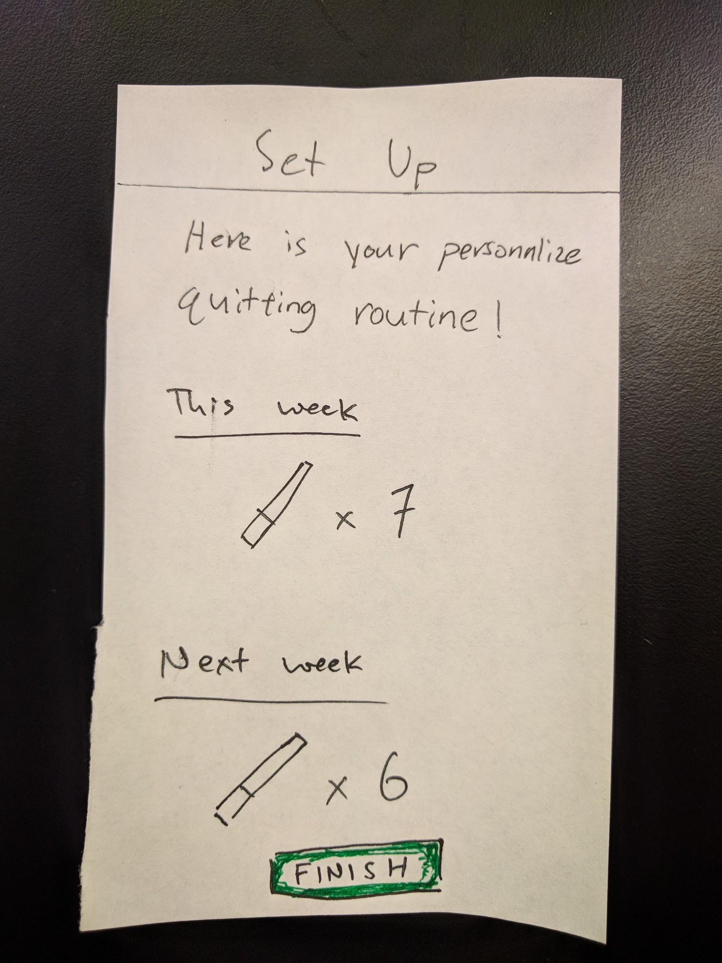
Task 1: Initial Setup and Tracking Nicotine/Tar

Slide 23
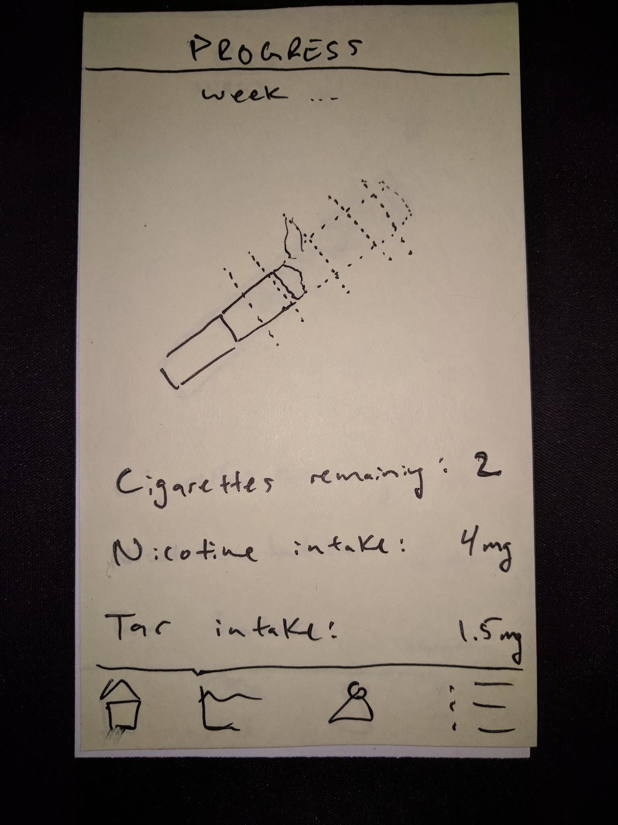
Task 1: Initial Setup and Tracking Nicotine/Tar

Slide 24
Task 1: Initial Setup and Tracking Nicotine/Tar

Slide 25
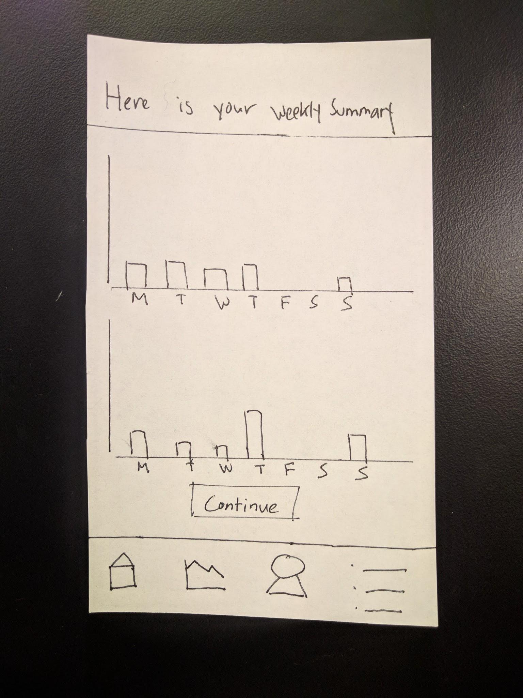
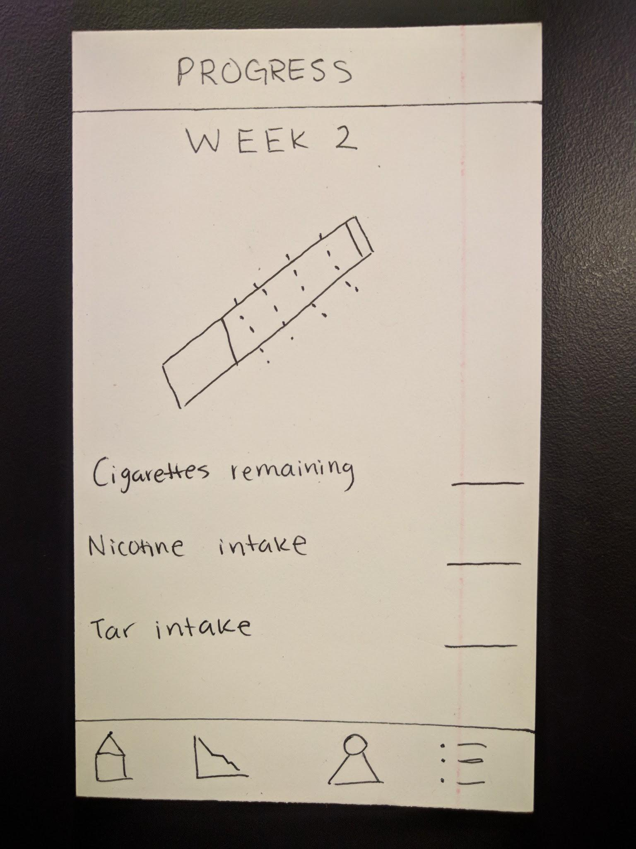
Task 1: Initial Setup and Tracking Nicotine/Tar

Slide 26
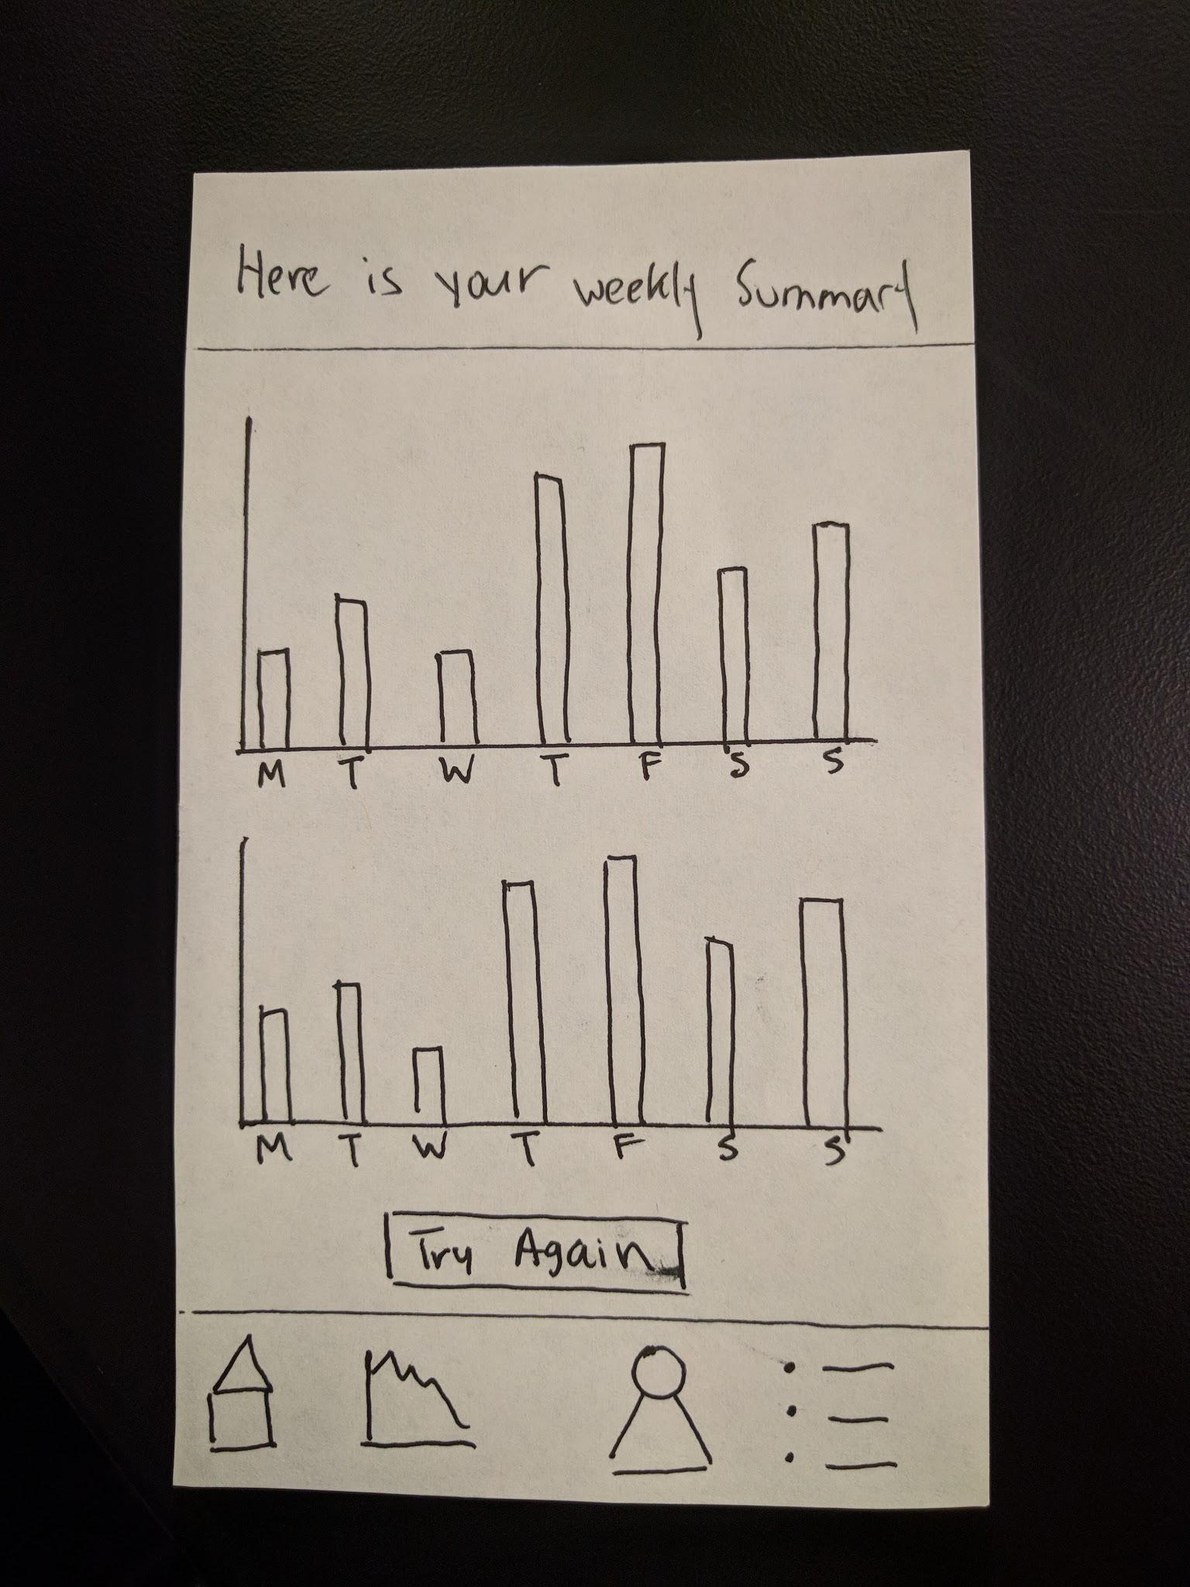
Task 1: Initial Setup and Tracking Nicotine/Tar
Notes:
Bigger notches for visibility

Slide 27
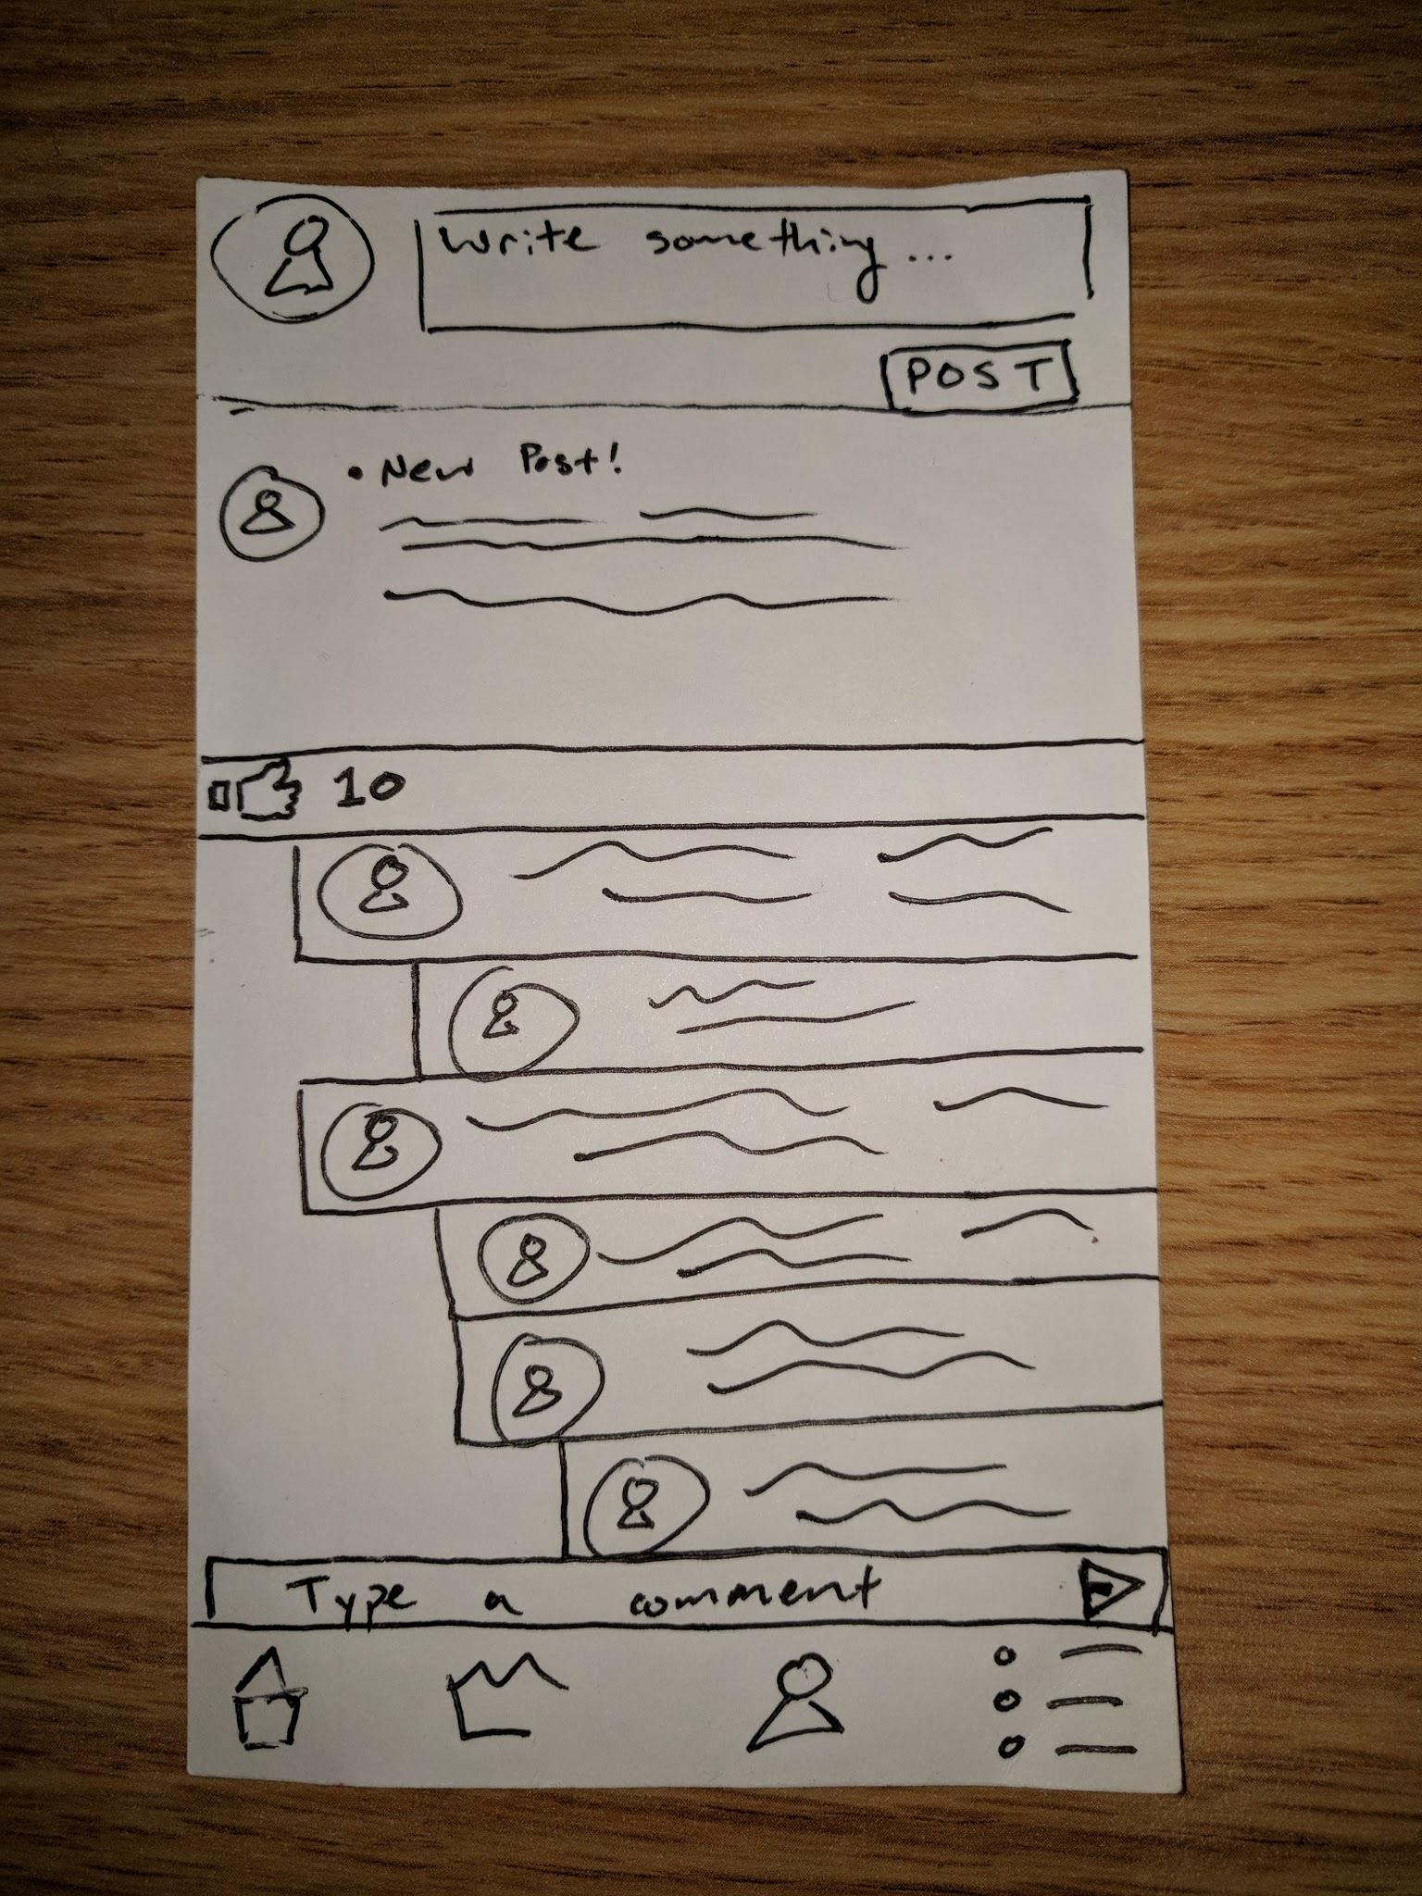
Task 2: Post to Cease Social Network
Notes:
Modified comment chain to increase visibility and display nested comments

Slide 28
Task 2: Post to Cease Social Network

Slide 29
Task 2: Post to Cease Social Network

Slide 30
Digital Mockup

Slide 31
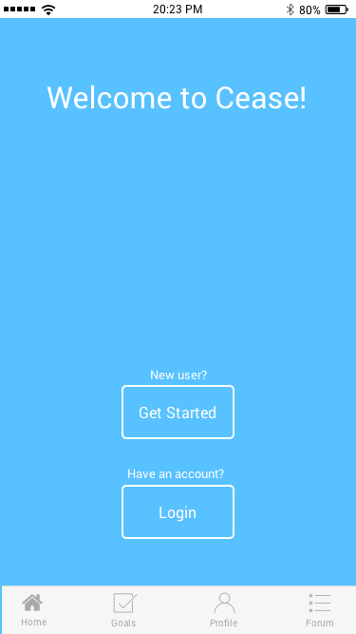
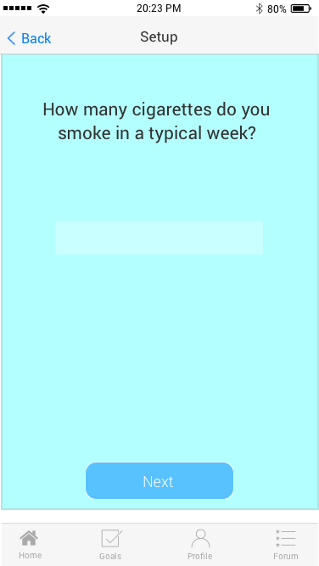
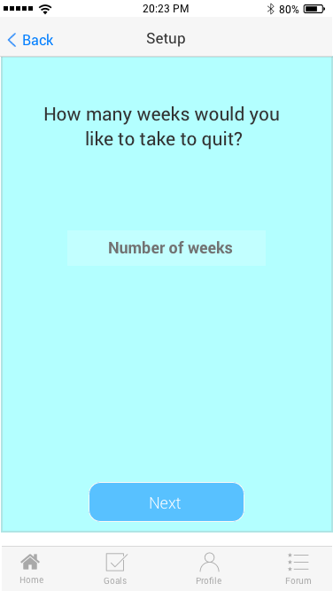
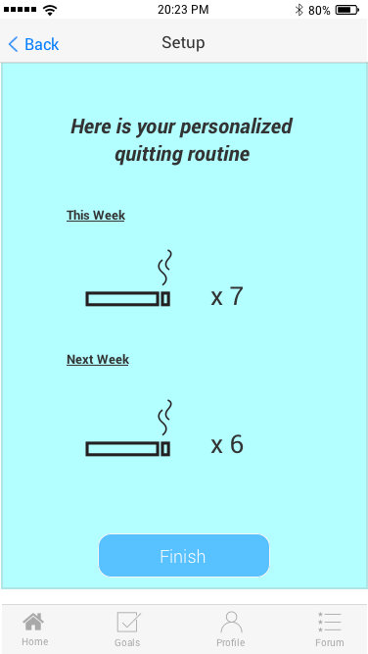
Task 1: Initial Setup and Tracking Nicotine/Tar

Slide 32
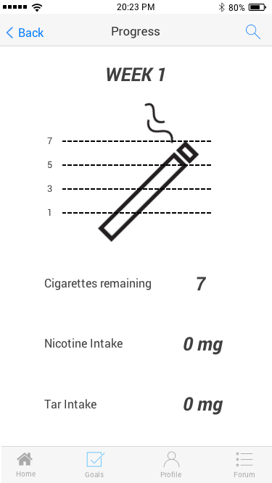
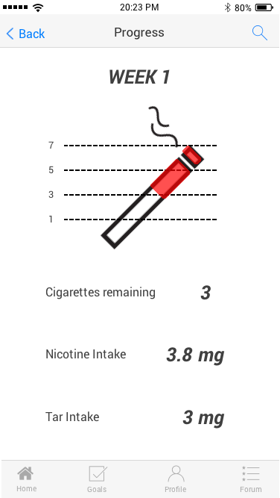
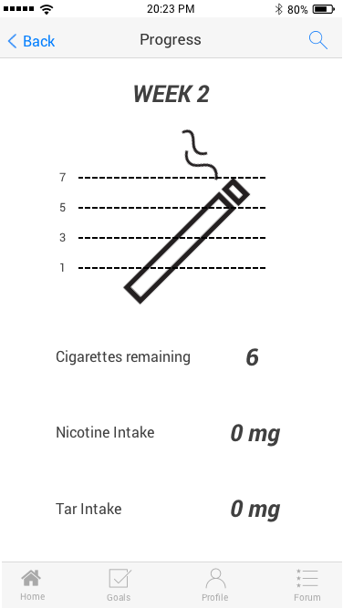
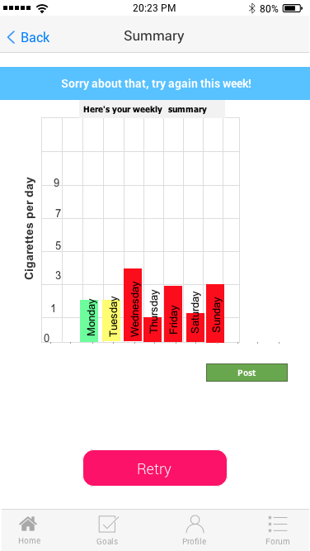
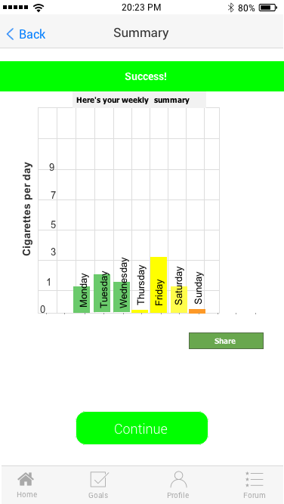
Task 1: Initial Setup and Tracking Nicotine/Tar

Slide 33
Task 1: Initial Setup and Tracking Nicotine/Tar

Slide 34
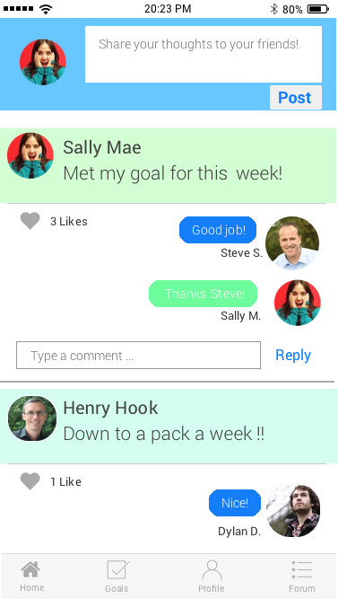

Task 2: Post to Cease Social Network

Slide 35
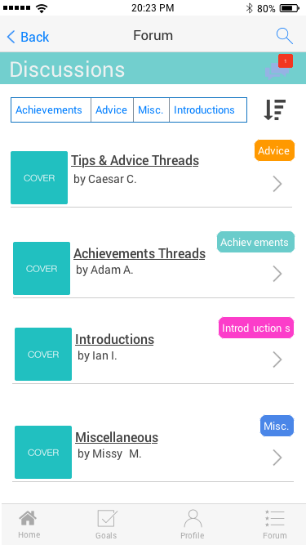

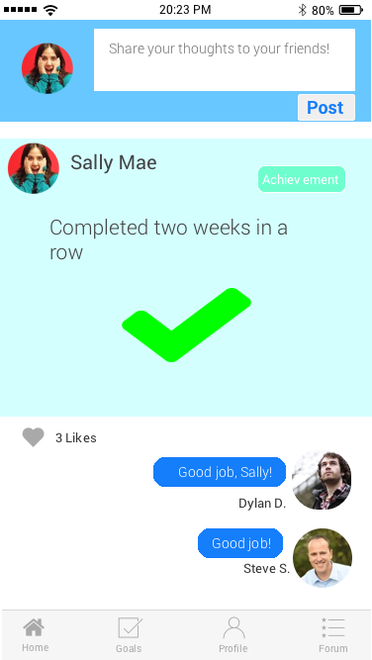
Task 2 extended: The Cease Social Network

Slide 36
Summary

Slide 37
Summary
Iterative design allows an effective way to explore different ideas
Paper prototype provides quick way to test design interface
Minimalistic design to allow ease of use
No need to reinvent the wheel

Slide 38
Thanks!

